Slide 1
Rolling the Root KSK
Geoff Huston
APNIC Labs
September 2017

Slide 2
Will this break the Internet?

Slide 3
Why?
If we stuff up this trust anchor key roll then resolvers that perform DNSSEC validation will fail to provide responses
  For DNSSEC-signed names!
  and
  For unsigned names!
These resolvers will go completely dark if they lose their relationship with the signed root of the DNS

Slide 4
Ok – lets strip out the hyperbole!
Can we estimate the extent of the Internet’s population (both human and other) that MAY be impacted by this change in the DNSSEC Trust Anchors?
Can we estimate the LIKELY impact of this change?

Slide 5
How many users …
Send their DNS queries towards recursive resolvers that perform DNSSEC validation?
Because these resolvers WILL be sensitive to a change in the KSK and this number is an approximate estimate of the upper bounds of impact of the KSK change

Slide 6
Digression: Let’s measure DNSSEC

Slide 7
Understanding DNS Resolvers is “tricky”
What we would like to think happens in DNS resolution!
x.y.z?
x.y.z?
Authoritative
Nameserver
Client
DNS Resolver
x.y.z? 10.0.0.1
x.y.z? 10.0.0.1

Slide 8
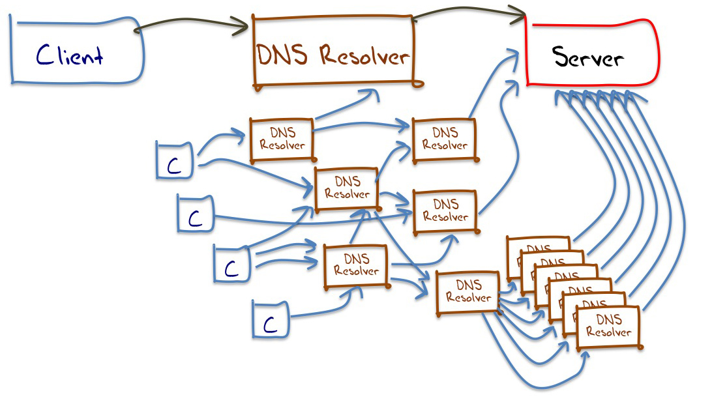
Understanding DNS Resolvers is “tricky”
A small sample of what appears to happen in DNS resolution

Slide 9
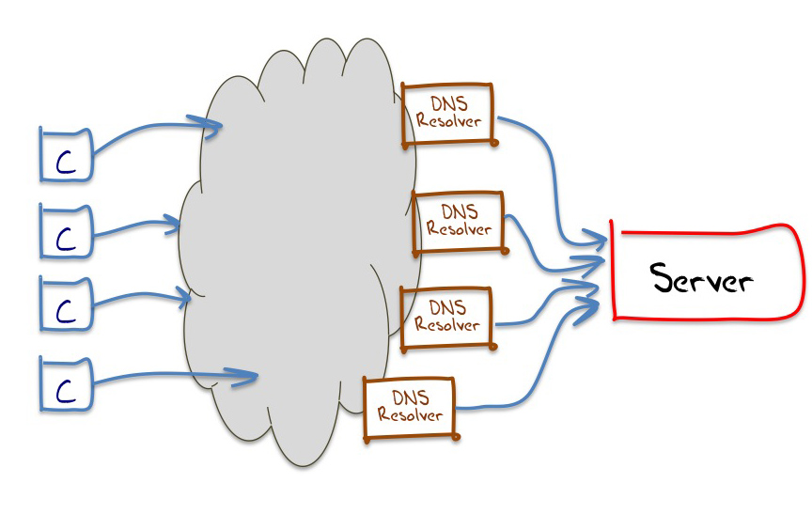
Understanding DNS Resolvers is “tricky”
The best model we can use for DNS resolution

Slide 10
Understanding Resolvers is “tricky”

Slide 11
This means…
That it’s hard to talk about “all resolvers”
  We don’t know the ratio of the number of resolvers we cannot see compared to the resolvers we can see from the perspective of an authoritative name server
We can only talk about “visible resolvers”

Slide 12
This means…
And there is an added issue here:
  It can be hard to tell the difference between a visible resolver performing DNSSEC validation and an occluded validating resolver performing validation via a visible non-validating forwarder

Slide 13
This means…
And there is an added issue here:
  It can be hard to tell the difference between a visible resolver performing DNSSEC validation and an occluded validating resolver performing validation via a visible non-validating forwarder
  (Yes, I know it’s a subtle distinction, but it makes looking at RESOLVERS difficult!)

Slide 14
This means…
It’s easier to talk about end clients rather than resolvers, and whether these end clients use / don’t use a DNS resolution service that performs DNSSEC validation

Slide 15
Ok – so measuring the DNS is tricky
But we want to measure DNSSEC validation.

Slide 16
Server-Side Measurement
We can’t instrument the user-side
Instead we instrument the server side, and capture all packets to the authoritative DNS servers and the web servers
So we are trying to infer the capabilities of the end user environment based upon the queries we see at our servers in response to passing the user a “known” question that they have to resolve

Slide 17
The Experiment
We have an online Ad that contains a scripted collection of URLS to fetch – when the ad is “impressed” the ad script is executed by the user and the user attempts to retrieve all the listed URLs
Three URLs:
the good (DNSSEC signed)
the bad (invalid DNSSEC signature)
the control (no DNSSEC at all)

Slide 18
DNSSEC Validating
DNSSEC-Validating resolvers will:
  ask for the DNSKEY and DS RRs for both names
  fetch the valid-signed object
  NOT fetch the Invalid-signed object
Non DNSSEC-validating resolvers will:
  Not ask for DNSKEY and DS RRs
  fetch both objects
But what if I have two resolvers in my local config, one validates, one does not?
    ask for the DNSKEY and DS RRs for both names
    fetch both objects

Slide 19
DNSSEC Validating
DNSSEC-Validating resolvers will:
  ask for the DNSKEY and DS RRs for both names
  fetch the valid-signed object
  NOT fetch the Invalid-signed object
Non DNSSEC-validating resolvers will:
  Not ask for DNSKEY and DS RRs
  fetch both objects
But what if I have two resolvers in my local config, one validates, one does not?
    ask for the DNSKEY and DS RRs for both names
    fetch both objects
DNSSEC Validating

Slide 20
So lets measure DNSSEC
How many users use ONLY DNS resolvers that perform DNSSEC validation?

Slide 21
Measurement Results
August 2017
  Presented: 426,676,126 experiments to clients
  53,121,177 experiments showed behaviour that was consistent with DNSSEC validation
  i.e. 12.45% of users use DNSSEC-validating resolvers!

Slide 22
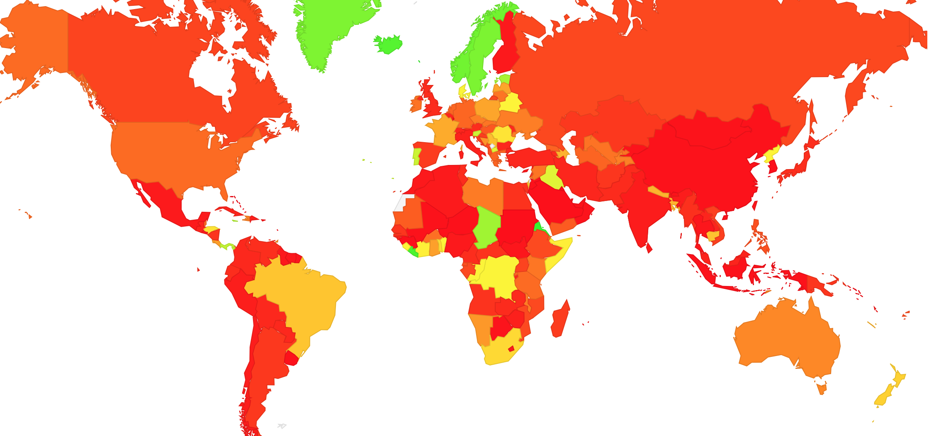
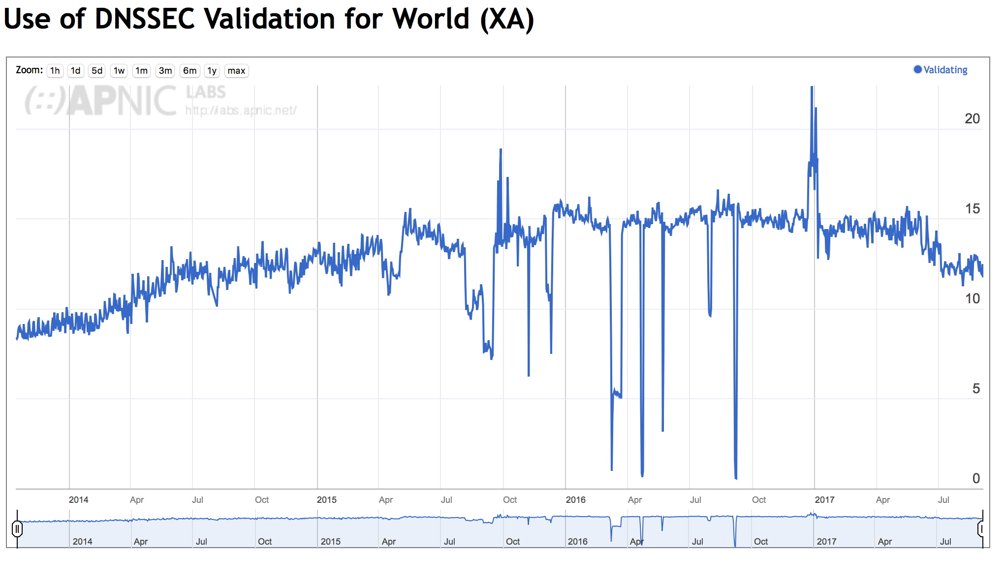
Measurement Results
August 2017
  Presented: 426,676,126 experiments to clients
  53,121,177 experiments showed behaviour that was consistent with DNSSEC validation
  i.e. 12.45% of users use DNSSEC-validating resolvers!

Slide 23
DNSSEC Validating
DNSSEC-Validating resolvers will:
  ask for the DNSKEY and DS RRs for both names
  fetch the valid-signed object
  NOT fetch the Invalid-signed object
Non DNSSEC-validating resolvers will:
  Not ask for DNSKEY and DS RRs
  fetch both objects
But what if I have two resolvers in my local config, one validates, one does not?
    ask for the DNSKEY and DS RRs for both names
    fetch both objects
12.45%

Slide 24
“Partial” DNSSEC Validating
DNSSEC-Validating resolvers will:
  ask for the DNSKEY and DS RRs for both names
  fetch the valid-signed object
  NOT fetch the Invalid-signed object
Non DNSSEC-validating resolvers will:
  Not ask for DNSKEY and DS RRs
  fetch both objects
But what if I have two resolvers in my local config, one validates, one does not?
    ask for the DNSKEY and DS RRs for both names
    fetch both objects
12.45%
5.75%

Slide 25
DNSSEC Use in the Internet
There is a lot of DNSSEC validation out there!
Users
20% don’t ask for DNSSEC credentials at all
62% ask, but don’t validate the response
6% validate but don’t take ‘NO’ for an answer!
12% validate, and accept ‘NO’ as an answer!

Slide 26
End Digression

Slide 27
Ok – lets strip out the hyperbole!
Can we estimate the extent of the Internet’s population (both human and other) that MAY be impacted by this change in the DNSSEC Trust Anchors?
Can we estimate the LIKELY impact of this change?

Slide 28
Ok – lets strip out the hyperbole!
Can we estimate the extent of the Internet’s population (both human and other) that MAY be impacted by this change in the DNSSEC Trust Anchors?
Can we estimate the LIKELY impact of this change?
Somewhere between 1 in 5 and 1 in 8 users use DNSSEC-aware DNS rtesolvers

Slide 29
Ok – lets strip out the hyperbole!
Can we estimate the extent of the Internet’s population (both human and other) that MAY be impacted by this change in the DNSSEC Trust Anchors?
Can we estimate the LIKELY impact of this change?
Somewhere between 1 in 5 and 1 in 8 users use DNSSEC-aware DNS rtesolvers

Slide 30
Our Major Concerns
That resolvers who validate DNS responses will fail to pick up the new DNS root key
  they do not have code that follows RFC5011 procedures for the introduction of a new KSK
  Or they are using a manually loaded key as the trust point
  Or they came in late!
The resolvers will be unable to receive the larger DNS responses that will occur during the dual signature phase of the rollover

Slide 31
Let the keys roll automatically
# // recursive resolver configuration - Bind
…
managed-keys {
. initial-key 257 3 5 "AwEAAfdqNV
JMRMzrppU1WnNW0PWrGn4x9dPg
…
=„; };
A Bind resolver uses the “managed keys” clause in its configuration to allow the KSK to be managed automatically.
When a new KSK is added to the DNSKEY record of the root, signed by the trusted key, then the resolver recognises this as a candidate trusted key. After 30 days of continuous publication of this new key, the resolver is prepared to trust the new KSK

Slide 32
Easy, Right? Just follow RFC5011…
Publish a new KSK and include it in DNSKEY responses, signed by the old KSK
  Resolvers use old-signs-over-new to pick up the new KSK, validate it using the old KSK, and add the new KSK to the local cache of trust anchor material (i.e. this steps allows resolvers to “learn” the new KSK as a trust point)
Wait
  For at least 30 days
Withdraw the old KSK
  And sign the DNSKEY RR in the root zone with only the new KSK
Wait
  For a a while
Revoke the old KSK
  Because its never wise to keep old information in a trusted state

Slide 33
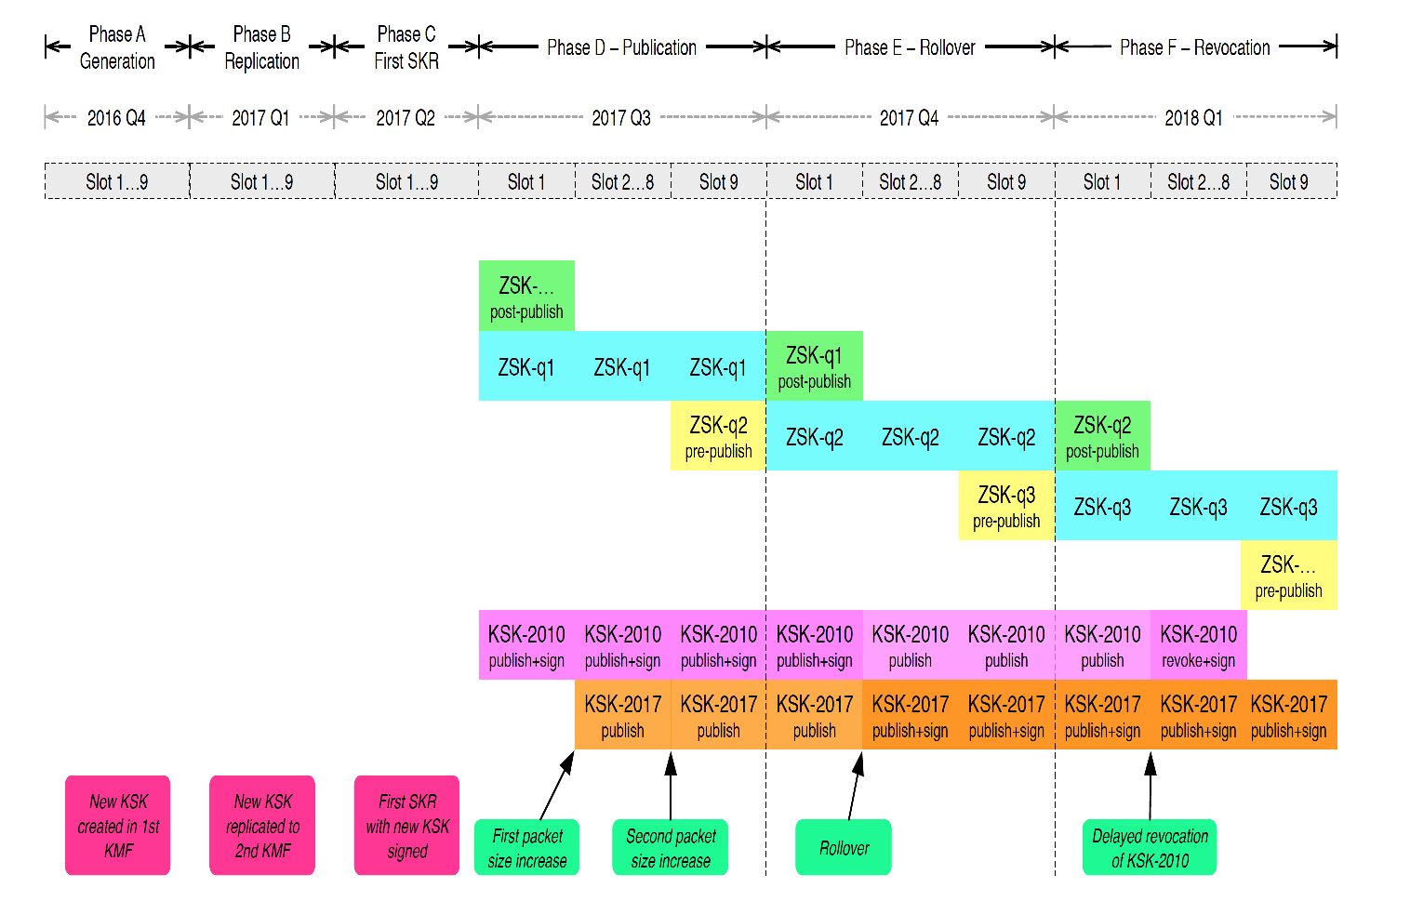
Publish
Withdraw
Revoke
Wait
Wait
https://www.icann.org/en/system/files/files/ksk-rollover-operational-implementation-plan-22jul16-en.pdf

Slide 34
Our Major Concerns
That resolvers who validate DNS responses will fail to pick up the new DNS root key
  they do not have code that follows RFC5011 procedures for the introduction of a new KSK
  Or they are using a manually loaded key as the trust point
  Or they came in late!

Slide 35
Our Major Concerns
That resolvers who validate DNS responses will fail to pick up the new DNS root key
  they do not have code that follows RFC5011 procedures for the introduction of a new KSK
  Or they are using a manually loaded key as the trust point
  Or they came in late!
We can’t measure (yet) how many resolvers will pick up the new KSK
If RFC8145 was commonly implemented then we could tell what was going on with take up of the new key according to the RFC5011 procedures
But this tool is not around in resolvers yet
So we just can’t tell whether manually (mis)managed keys are prevalent or not
We will only know after October 11

Slide 36
Our Major Concerns
That resolvers who validate DNS responses will fail to pick up the new DNS root key
  they do not have code that follows RFC5011 procedures for the introduction of a new KSK
  Or they are using a manually loaded key as the trust point
  Or they came in late!
The resolvers will be unable to receive the larger DNS responses that will occur during the dual signature phase of the rollover

Slide 37
1,139
1,414
1,139
1,414
1,425

Slide 38
Large Responses
The larger DNS responses invoke different behaviours:
  Some root servers hand back a large unfragmented UDP packet
  Some root services hand back a fragmented UDP packet
  Some root servers hand back a truncated UDP packet, with fallback to TCP

Slide 39
Large Responses
This presents a problem with testing – not all root server instances behave the same way when delivering large responses
We can test each behaviour in isolation, but to test the diversity of the root server environment is beyond the capabilities of reasonable accuracy of our ad-based measurement framework
Our tests with 1,430 octet responses in IPv4 show that the noise component drowns out any coherent signal – the loss rate is less than 1%
IPv6 only has a higher loss rate for UDP fragmentation (40%), but as long as a resolver is dual-stack then this is not a major operational issue
As a related data point, .org has been running a DNSKEY response of 1,650 octets for some years, and nobody is calling out .org as an operational failure!

Slide 40
Large Responses
This presents a problem with testing – not all root server instances behave the same way when delivering large responses
We can test each behaviour in isolation, but to test the diversity of the root server environment is beyond the capabilities of reasonable accuracy of our ad-based measurement framework
Our tests with 1,430 octet responses in IPv4 show that the noise component drowns out any coherent signal – the loss rate is less than 1%
IPv6 only has a higher loss rate for UDP fragmentation (40%), but as long as a resolver is dual-stack then this is not a major operational issue
As a related data point, .org has been running a DNSKEY response of 1,650 octets for some years, and nobody is calling out .org as an operational failure!
We don’t expect large response failure to be a major factor in KSK roll ’breakage’

Slide 41
Ok – lets strip out the hyperbole!
Can we estimate the extent of the Internet’s population (both human and other) that MAY be impacted by this change in the DNSSEC Trust Anchors?
Can we estimate the LIKELY impact of this change?
Somewhere between 1 in 5 and 1 in 8 users use DNSSEC-aware DNS rtesolvers
We have no idea about the extent of issues with manual key management
Less than 1 in 100 MIGHT be affected by the large response size

Slide 42
Where are we?
A key roll of the Root Zone KSK will cause some DNS resolvers to fail:
  Resolvers who do not pick up the new key in the manner described by RFC5011
  Resolvers who cannot receive a DNS response of >1,400 octets
  The failure will not occur at the exact time of the key roll – it will occur when the local cache of old signed root entries ages out of the cache, which will take up to 7 days
Many users who use these failing resolvers will just switch over to use a non-validating resolver
A small pool of users will be affected with no DNS

Slide 43
What can I do?
Check your recursive resolver config!
Check your trusted key set
There is no need to turn off DNSSEC validation!

Slide 44
Questions?

